Slide 1
Fear….
Lecia Floyd

Slide 2
Fear defined…
A distressing emotion aroused by impending danger, evil, pain, etc., whether the threat is real or imagined; the feeling or condition of being afraid.
www.dictionary.com

Slide 3
What is my biggest fear?
I really thought hard about what my fear was. I had several things come to mind, but I kept coming back to one thing. I know to most this is the furthest thing from a valid fear… but I am terrified. So much so that last week in class when Beth was talking about the assignment and I knew this is what I wanted to do, I felt nauseous and short of breath. This thing became my fear 2 years ago, and I’ve only been able to go back to it once (earlier this year) and just looking at it brought anxiety and tears.
So what’s my fear?...........

Slide 4
This slide at Holiday Park…

Slide 5
Seems somewhat silly huh?
To most this might seem silly… but if you think back to the definition of fear, it says it can be a distressing emotion aroused by impending danger, evil, pain, etc. The highlighted words are what gives me the fear of this slide.
So I guess by now you are wondering what in the world does fear, danger and pain have to do with this silly slide!
Well I’ll show you….

Slide 6
Broken ankle in 3 places & ripped all the ligaments…

Slide 7
5” metal plate, 8 screws, metal wires

Slide 8
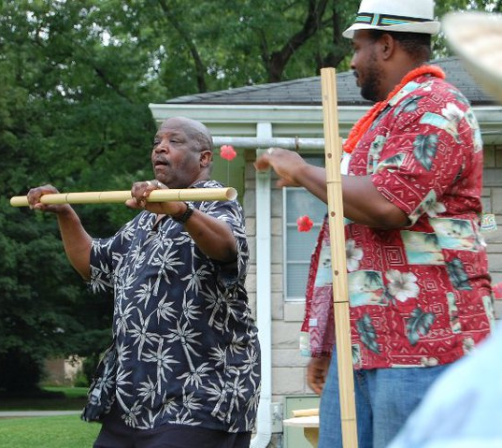
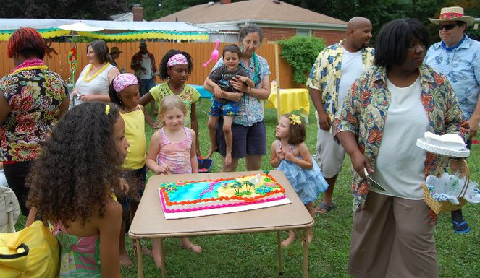
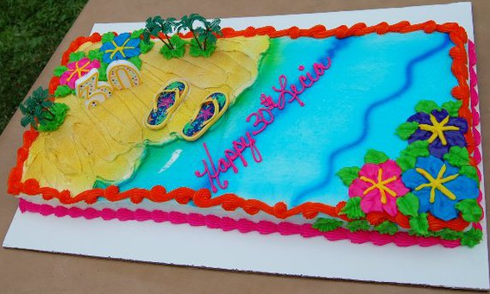
Distressing emotion…

Slide 9
Distressing emotion…
While everyone else got to enjoy my 30th “tacky tourist” party… I was stuck on crutches in a chair for most of my party with a faux-smile. I was not allowed to put any pressure of my foot/ankle for 6 weeks. Sitting back watching everyone else dance, limbo etc… was when my first onset of depression set in.
From there and for the next year to come… I slipped in to deep depression. I’ve always been a positive person, but the damage to my ankle was so severe that the negative effects (what I couldn’t do) were way greater than the positive effects (what I could still do). It seemed as if every time I would heal and move 1 step forward, my injury would knock me back 2 steps. Having 4 total surgeries on the ankle didn’t help.
I am still dealing with this as I was just diagnosed with arthritis in a part of my ankle. Because of it.. Sometimes my ankle gives out and I hit the floor.

Slide 10
Pain…
This is a word that has become a part of my daily vocabulary. There is a never a day that I don’t have pain… it just comes on different levels.
One of the reasons I am terrified of this slide is because I associate pain with it. When it broke, my ankle snapped backwards and my leg went all the way behind me. My foot was dangling when I get to the bottom of the slide so I had to crawl across mulch to get to the car and as a result, I cut my knees badly.
I have had several abdominal surgeries including 2 c-sections, so I’m all too familiar with pain… but this was a pain worse than anything I had ever experienced before.
Every time I have a pain, my ankle gives out on me or it stops me from doing something I enjoy, it makes me think of that slide and I fear that thing and am terrified something similar would happen if I ever got on it again.

Slide 11
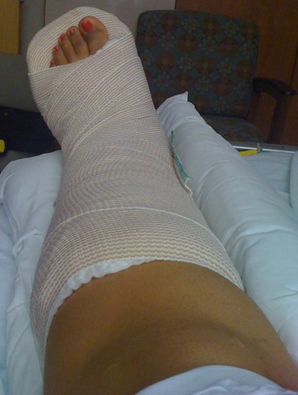
Pain…
Norco - Percocet - Valium - Ibuprofen

Slide 12
Danger…
When I think about the slide… I think of danger. I look at it the same way a person would look at guns or fire. This has become a negative association for me. In turn, it makes it difficult for me to take the kids to the park because I look at the slide as a dangerous thing.
I can handle looking at some slides just fine, but any slide that is twisty scares the crap out of me. I have taken my kids to the park less than 5 times since acquiring this fear, and those have all been this year.
The few times I have taken them to the park, I try to keep them off of the slides because I have the fear of them and in my eyes that could yield much danger.

Slide 13
Fear concluded….
As shown in this presentation my greatest fear is the curly slide. It has proven to me to be dangerous and cause emotional problems and tremendous fear.
This slide has caused damages that can never be fully fixed and the doctor said my ankle will always give me problems and will never be the same again.
The hardest part is this is a fear that will be hard for me to get around/over as long as I have kids and have to go to the park and have my ankle that has the permanent reminds of that horrible day that caused me to have a horrible fear……

Slide 14
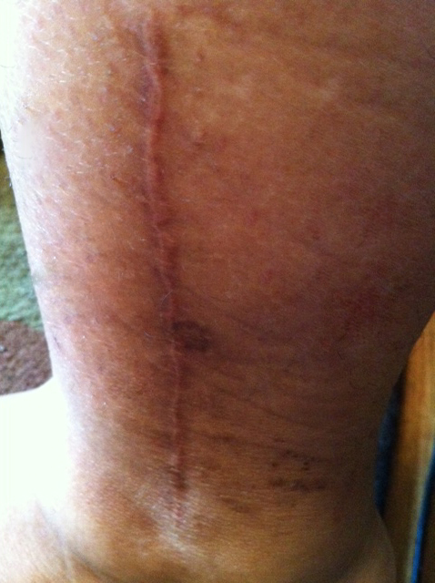
My permanent reminder of my fear…
“Reminder” scar on the inside of my ankle.
Large “reminder” scar on the outside of my ankle.

